Slide 1
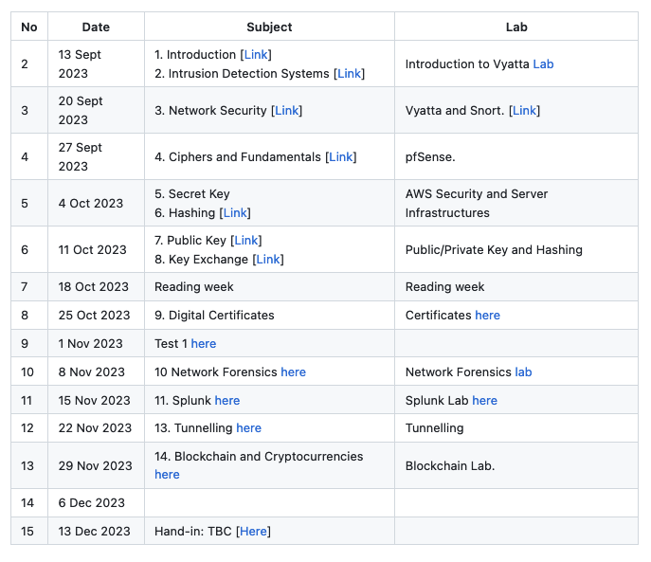

Symmetric Key Basics Block or Stream? Secret Key Methods Salting AES Key Entropy Prof Bill Buchanan OBE https://asecuritysite.com/symmetric

Slide 3
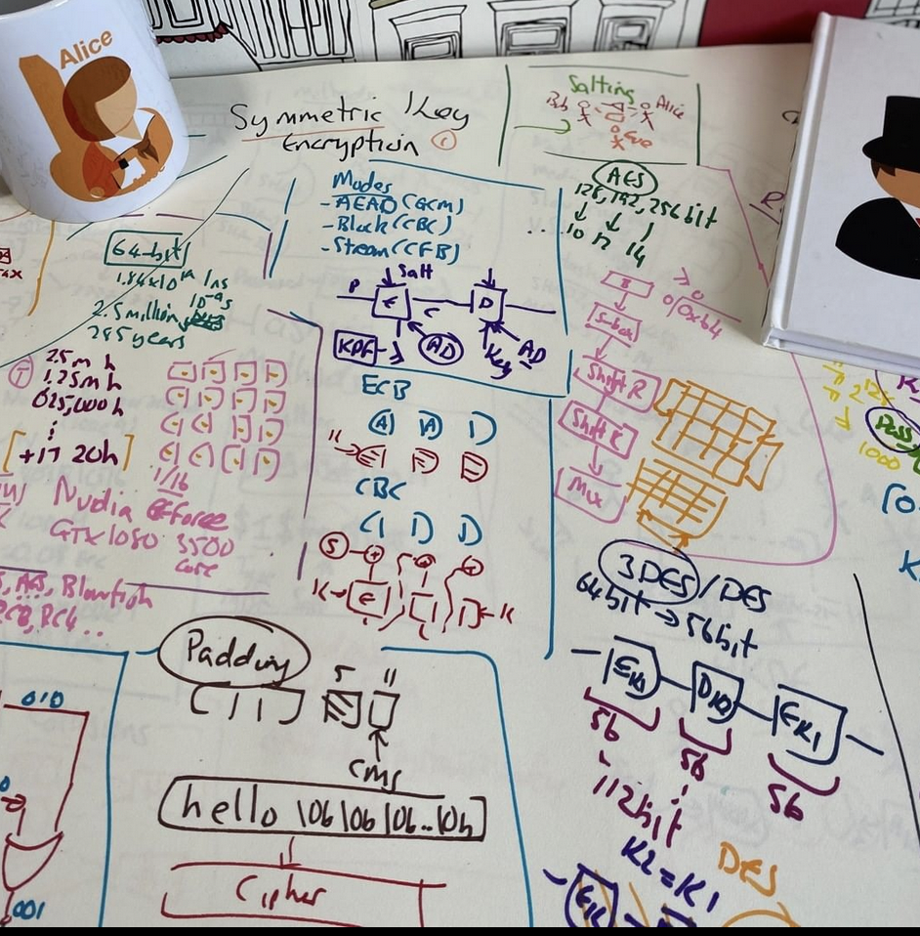
Secret Key Basics Block or Stream? Secret Key Methods Salting AES Key Entropy Prof Bill Buchanan OBE https://asecuritysite.com/symmetric

Slide 5
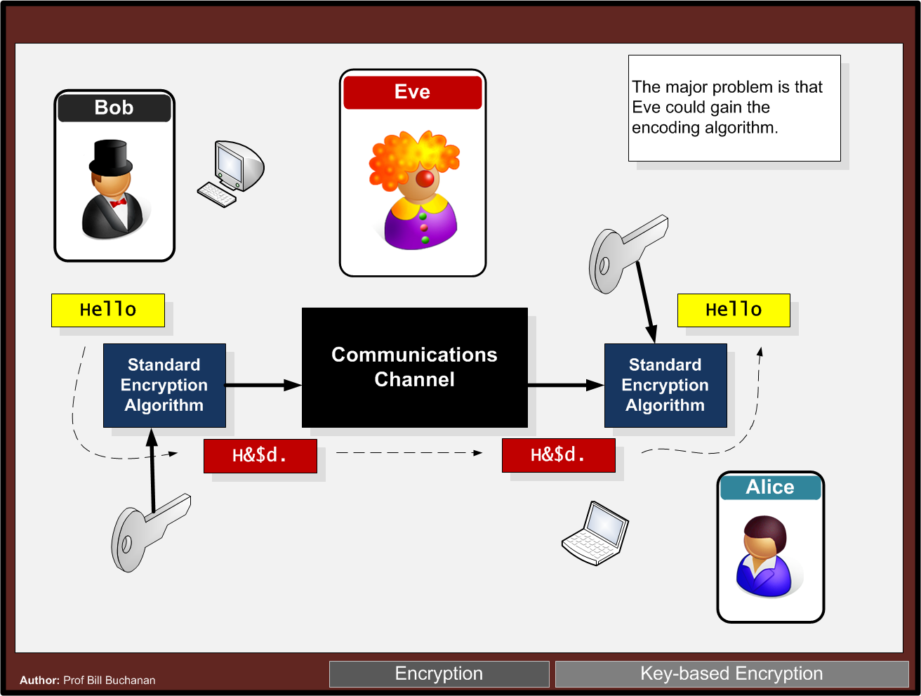

Slide 6
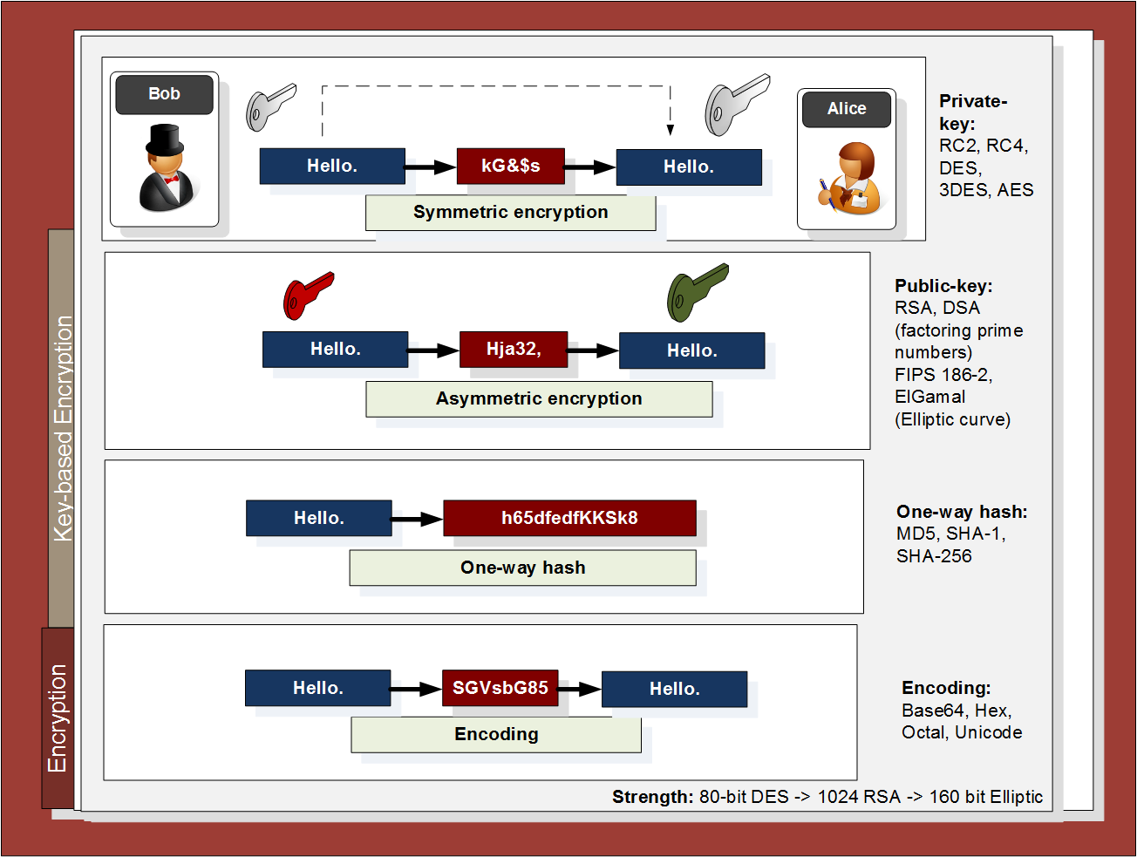

Slide 7
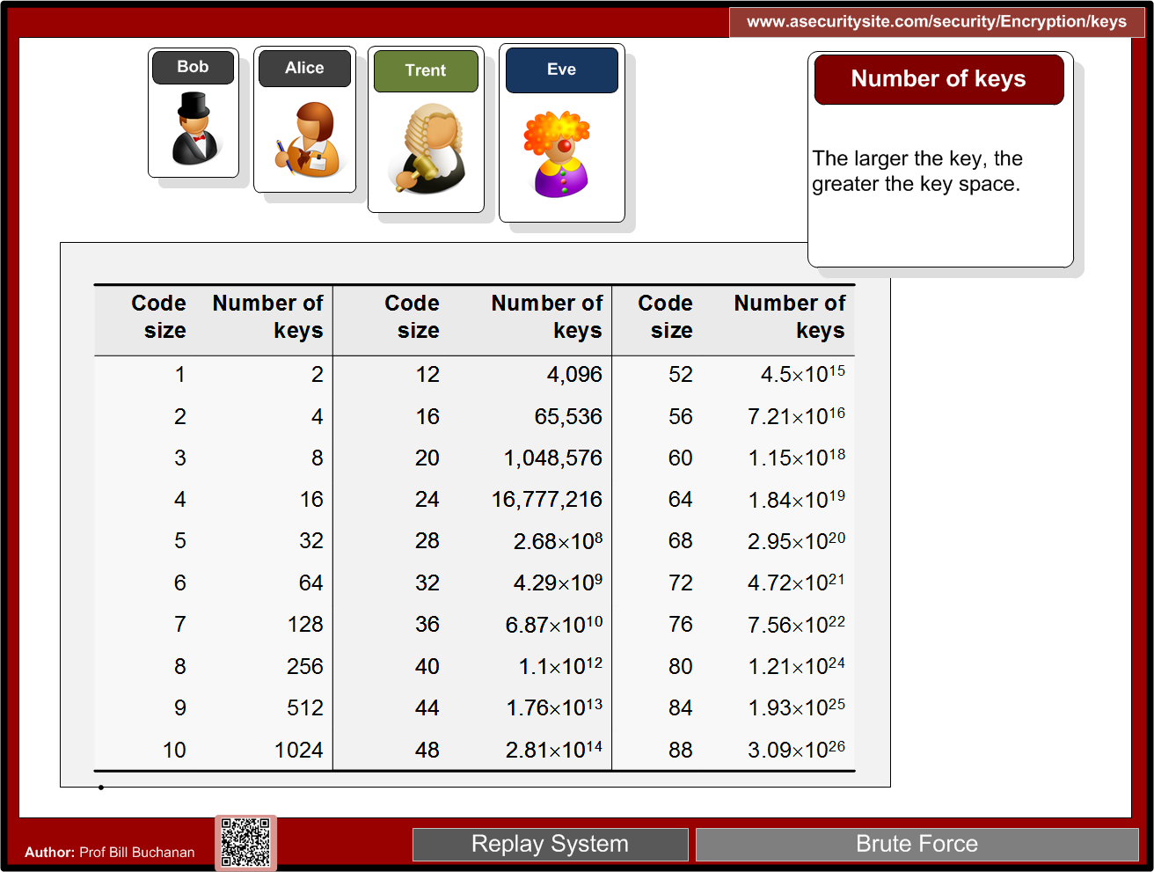
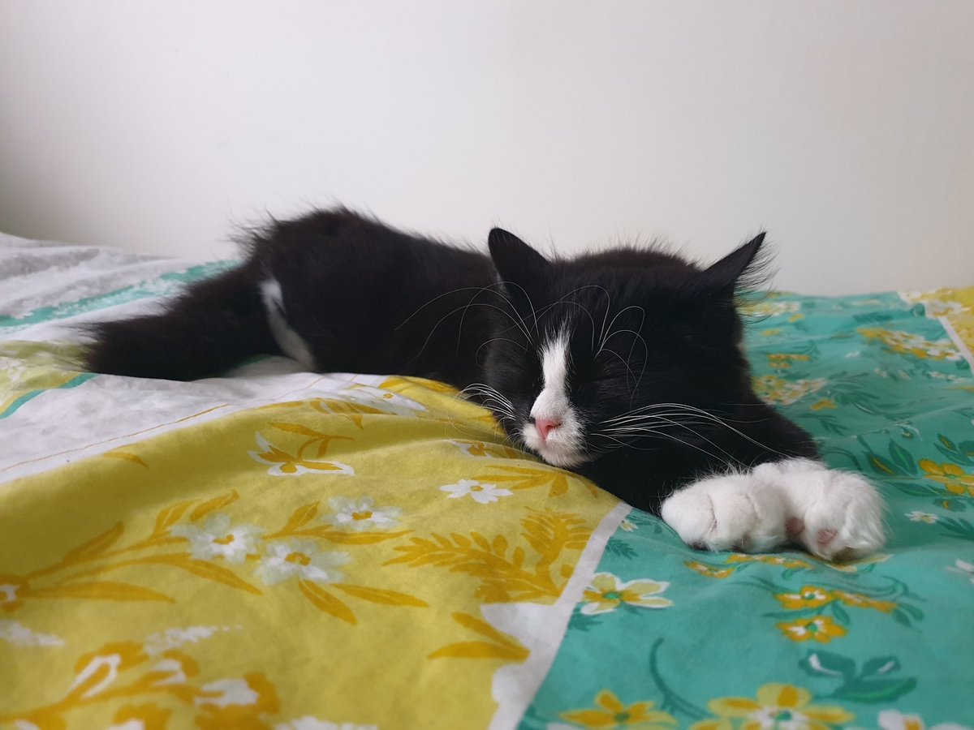
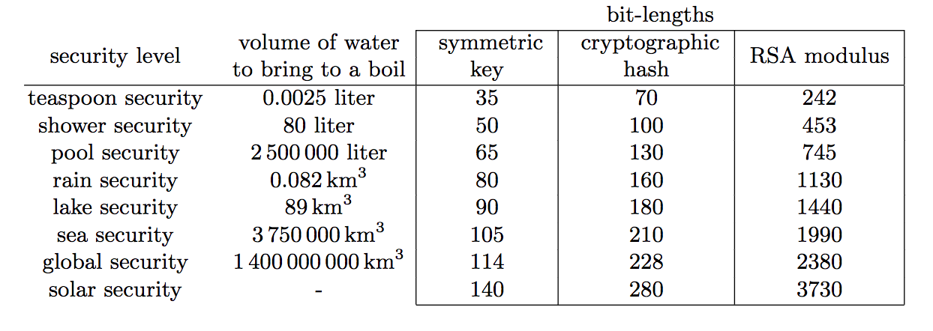

Slide 8
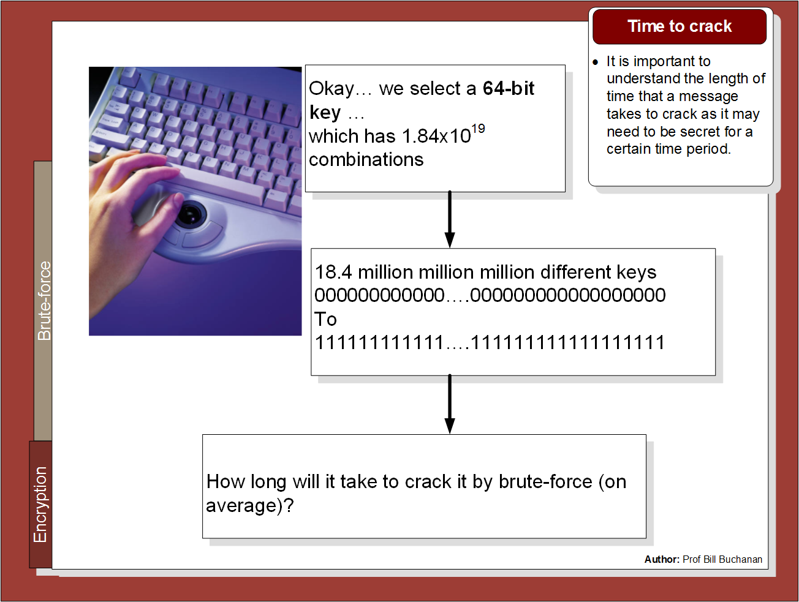

Slide 9
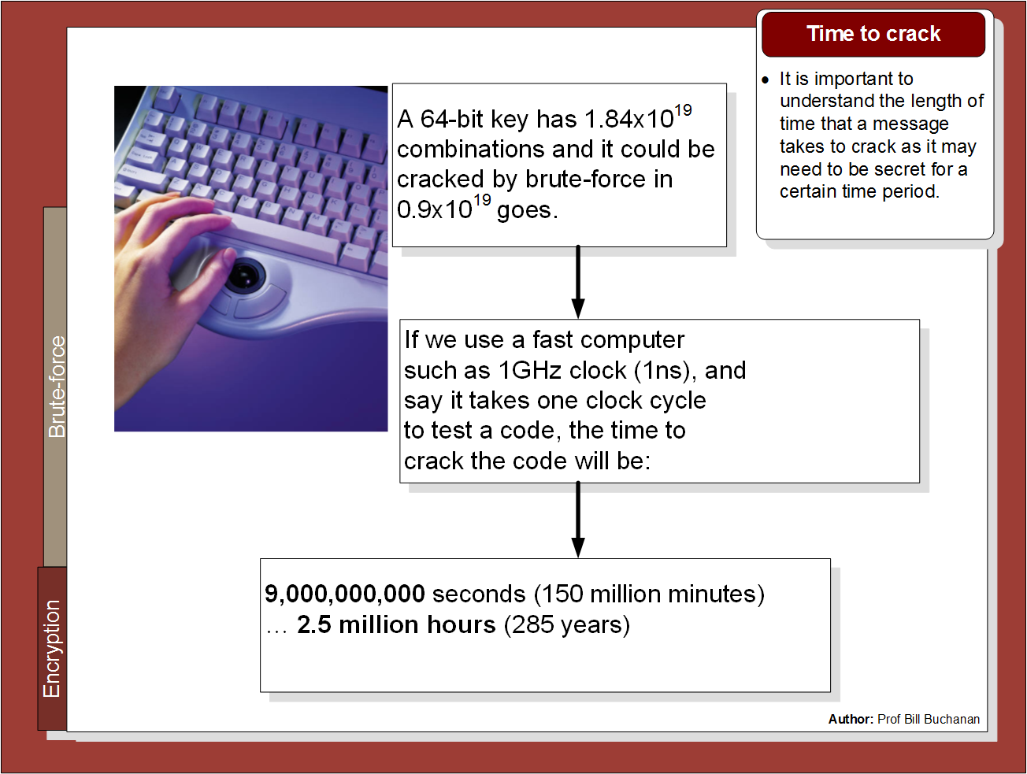

Slide 10
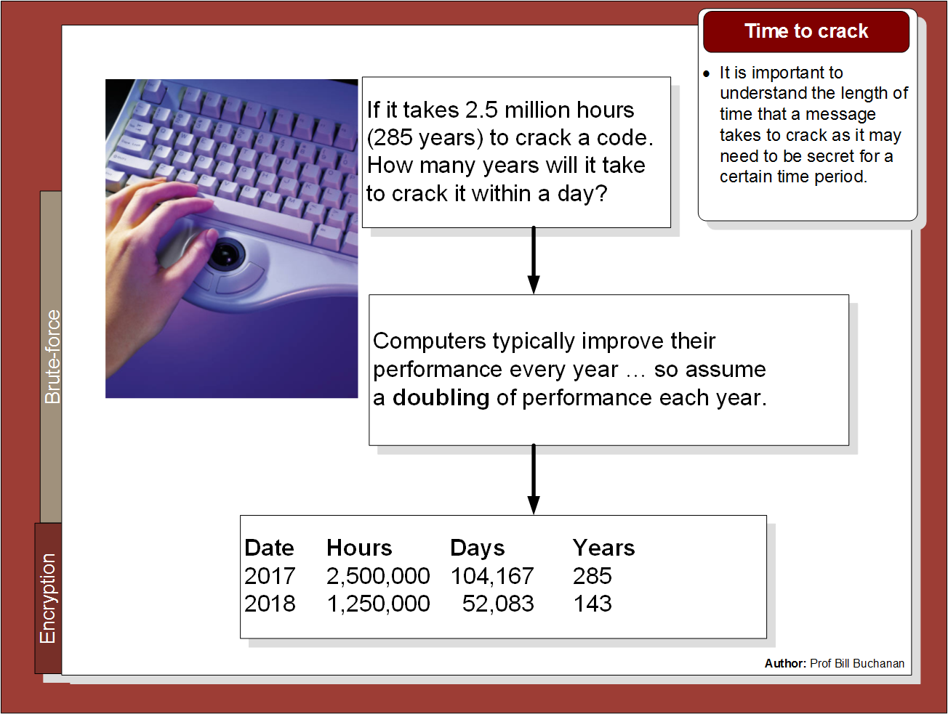

Slide 11
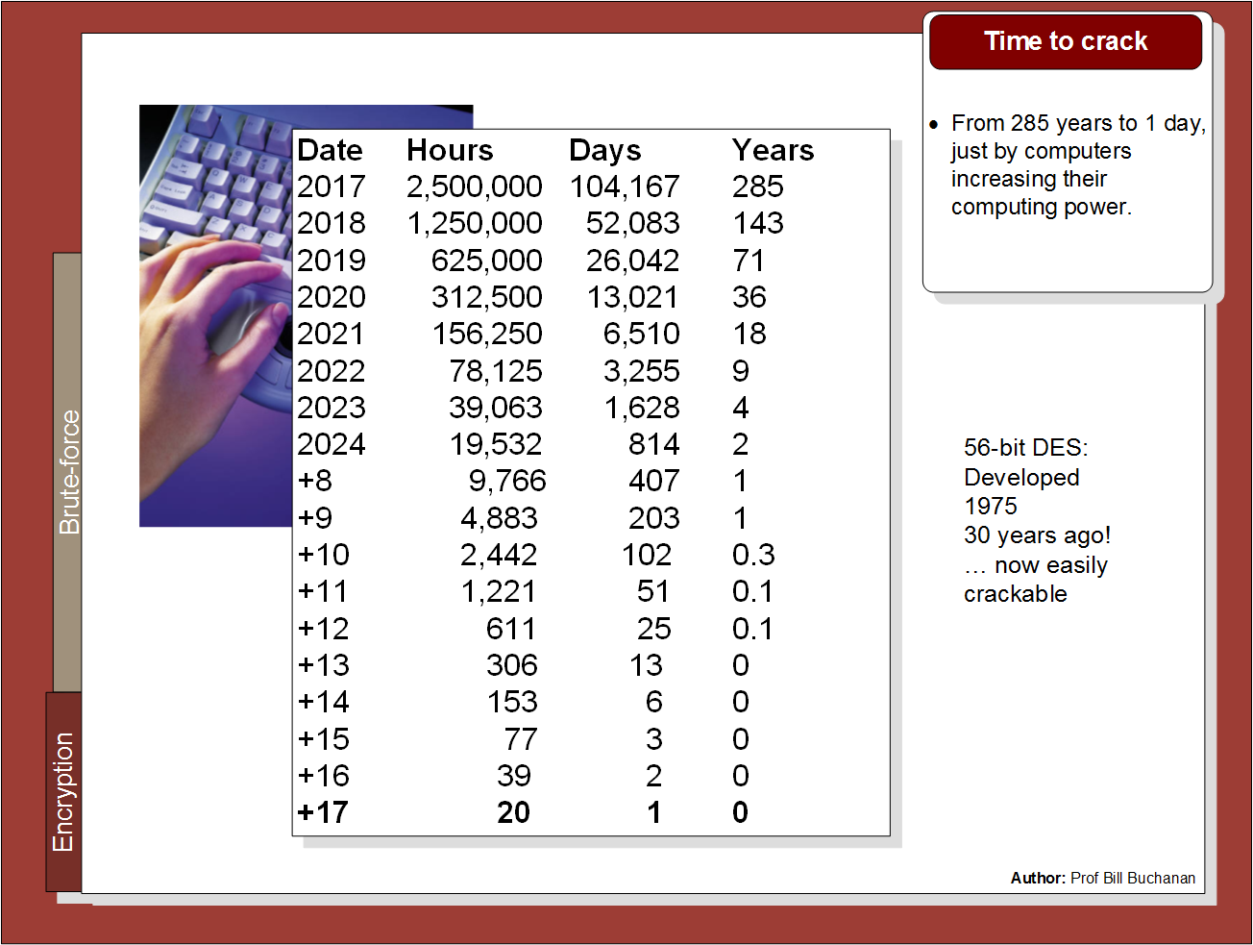

Slide 12
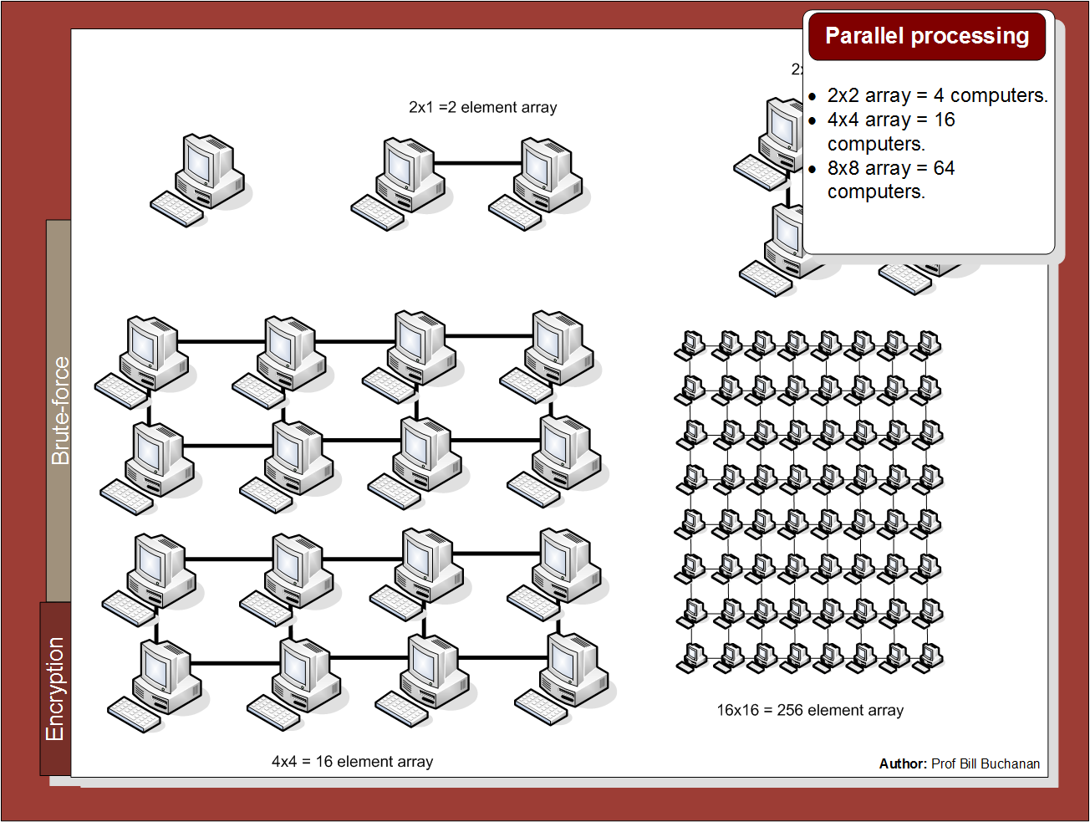

Slide 13
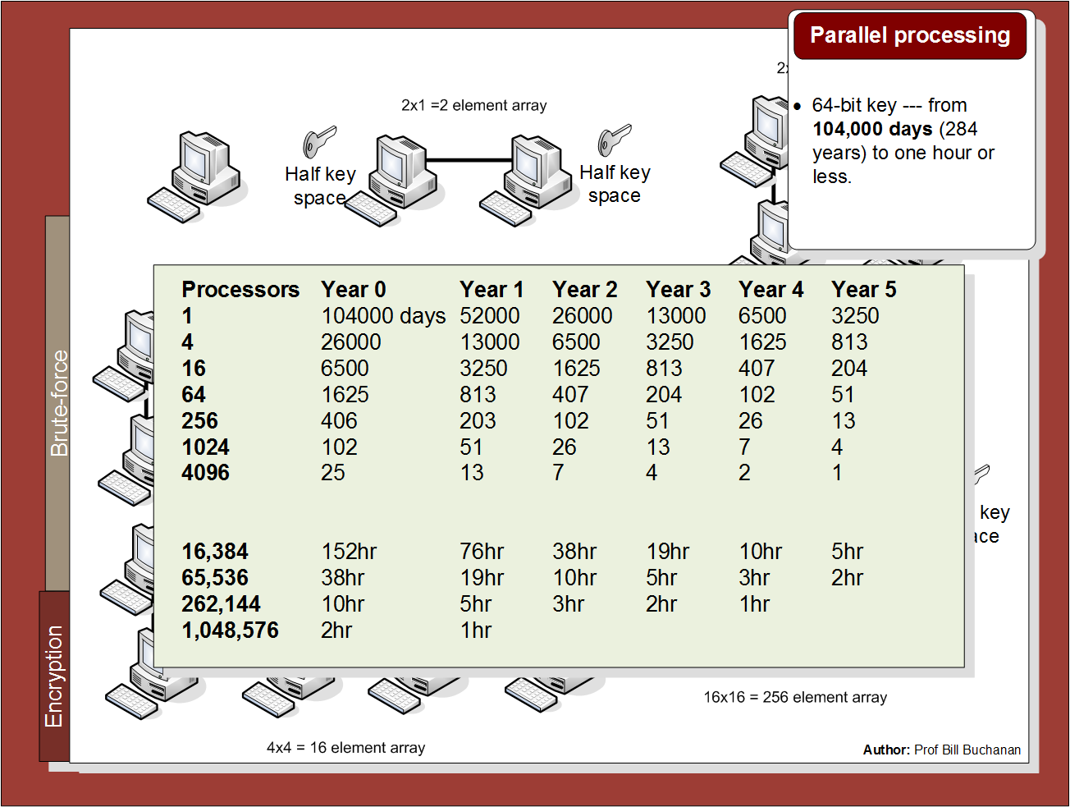

Slide 14
Symmetric Key Basics Block or Stream? Secret Key Methods Salting AES Key Entropy Prof Bill Buchanan OBE https://asecuritysite.com/symmetric

Slide 15
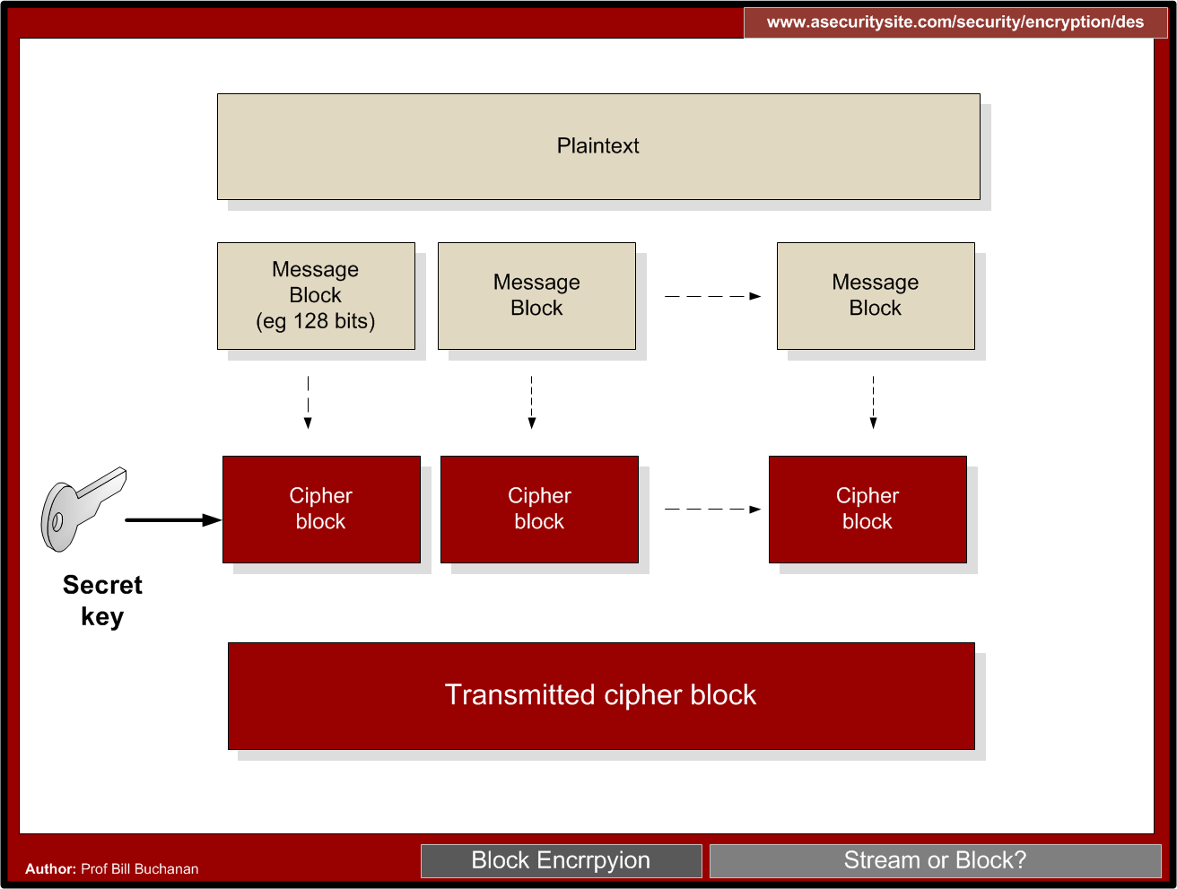

Slide 16
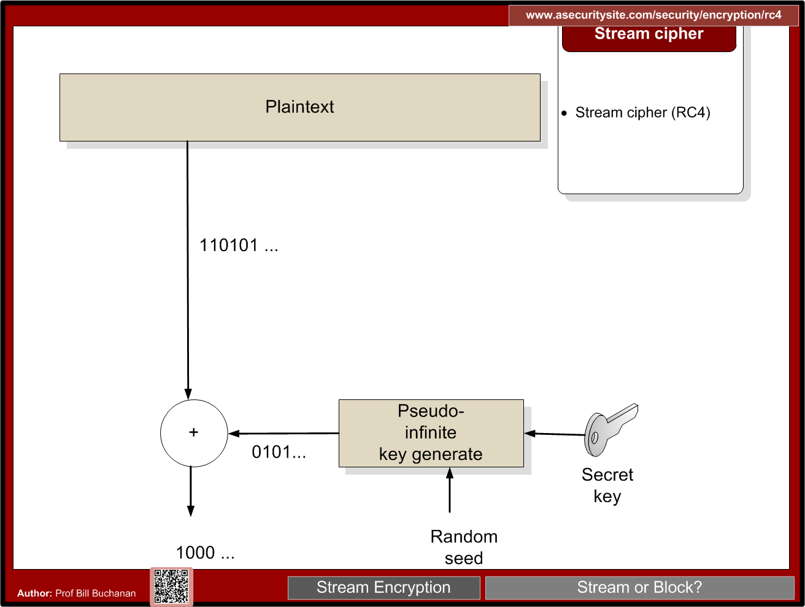

Slide 18
Padding
CMS (Cryptographic Message Syntax). This pads with the same value as the number of padding bytes. Defined in RFC 5652, PKCS#5, PKCS#7 and RFC 1423 PEM.
Bits. This pads with 0x80 (10000000) followed by zero (null) bytes. Defined in ANSI X.923 and ISO/IEC 9797-1.
ZeroLength. This pads with zeros except for the last byte which is equal to the number (length) of padding bytes.
Null. This pads will NULL bytes. This is only used with ASCII text.
Space. This pads with spaces. This is only used with ASCII text.
Random. This pads with random bytes with the last byte defined by the number of padding bytes.

Slide 19
Padding
After padding (CMS): 68656c6c6f0b0b0b0b0b0b0b0b0b0b0b Cipher (ECB): 0a7ec77951291795bac6690c9e7f4c0d
After padding (Bit): 68656c6c6f8000000000000000000000 Cipher (ECB): 731abffc2e3b2c2b5caa9ca2339344f9
After padding (ZeroLen): 68656c6c6f000000000000000000000a Cipher (ECB): d28e2f7e8e44e068732b292bde444245
After padding (Null): 68656c6c6f0000000000000000000000 Cipher (ECB): 444797422460453d95856eb2a1520ece
After padding (Space): 68656c6c6f0000000000000000000000 Cipher (ECB): 444797422460453d95856eb2a1520ece
After padding (Random): 68656c6c6ffc6ecfd884a38798d62a0a Cipher (ECB): c2c88b4364d2c2dc6f2cac9ab73c995d

Slide 20
Symmetric Key Basics Block or Stream? Secret Key Methods Salting AES Key Entropy Prof Bill Buchanan OBE https://asecuritysite.com/symmetric

Slide 22
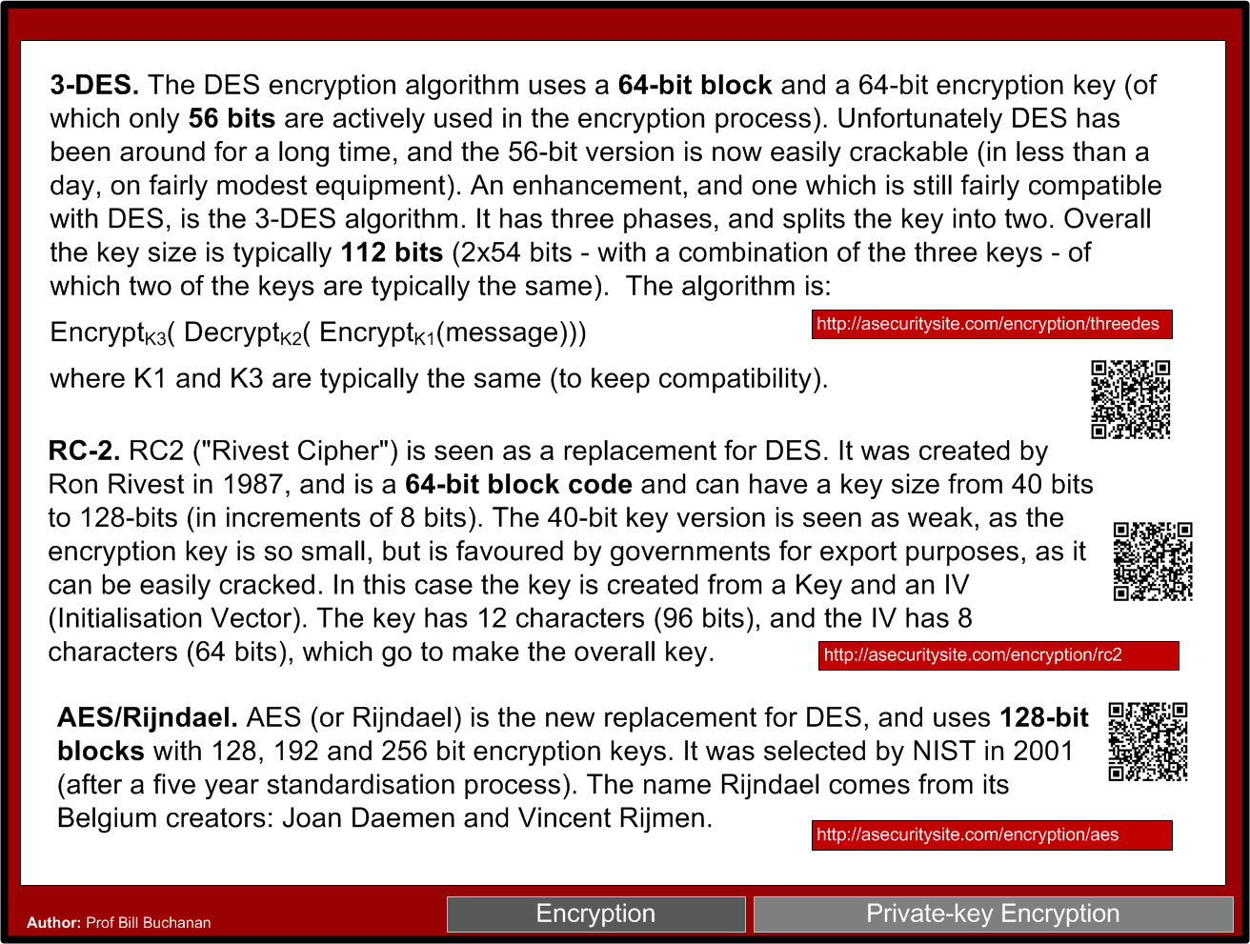

Slide 23


Slide 24
Symmetric Key Basics Block or Stream? Secret Key Methods Salting AES Key Entropy Prof Bill Buchanan https://asecuritysite.com/symmetric

Slide 25
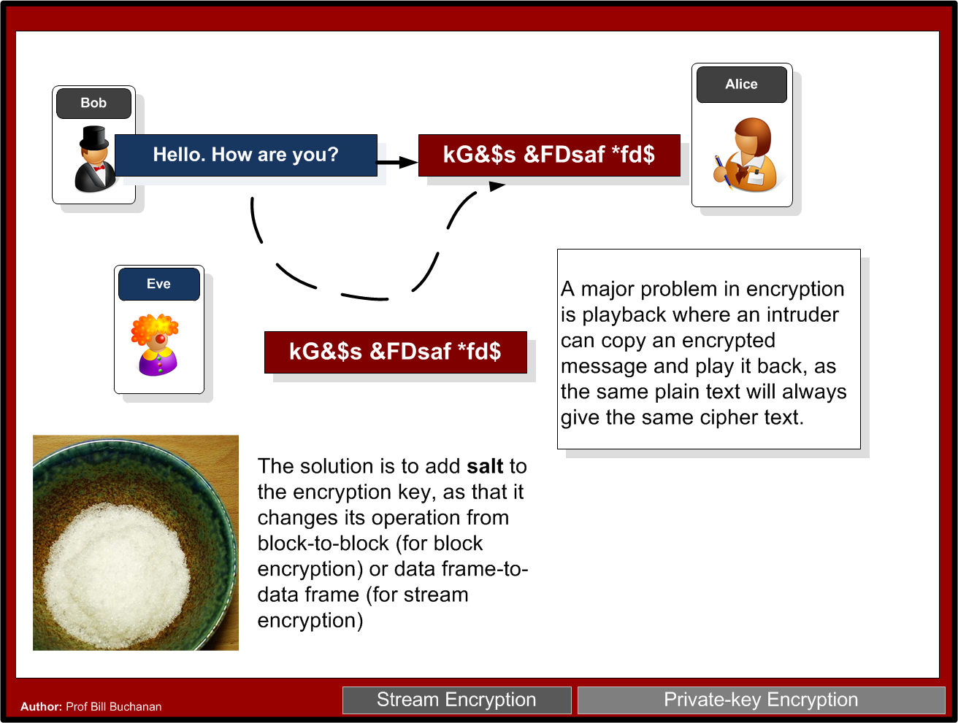

Slide 26
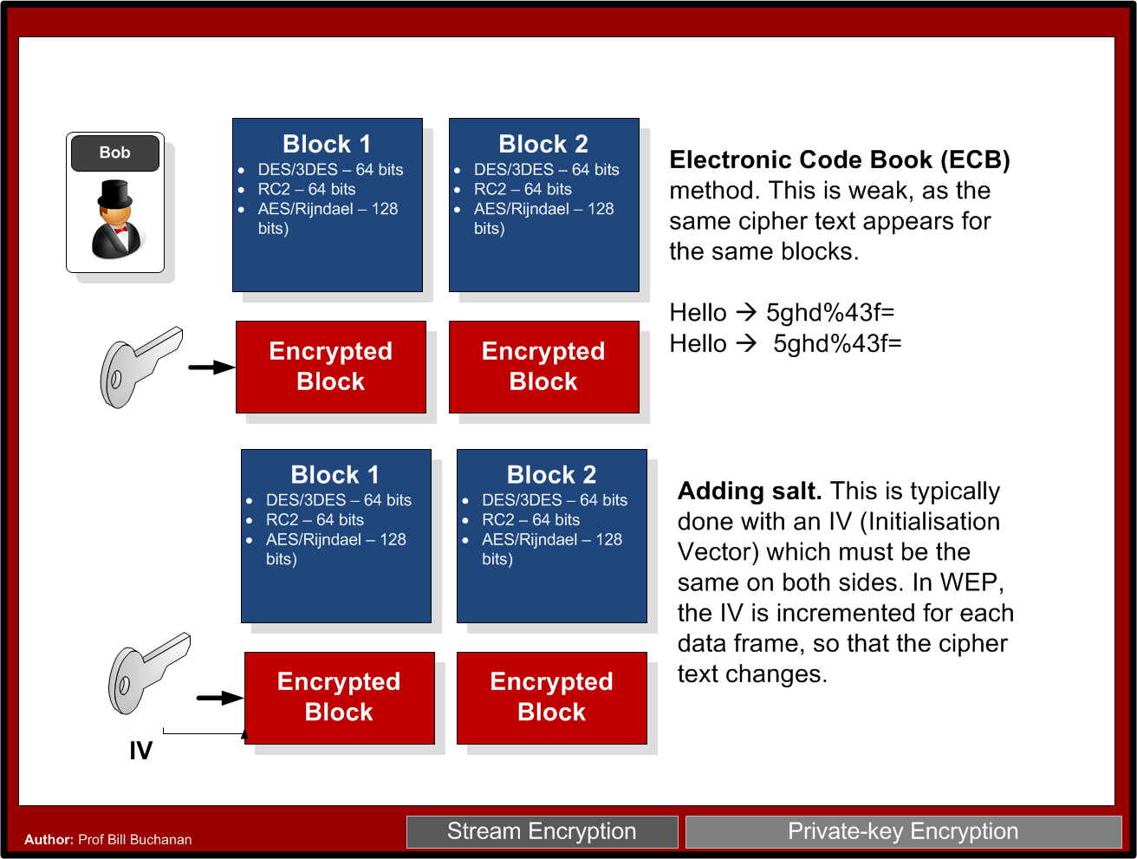

Slide 27
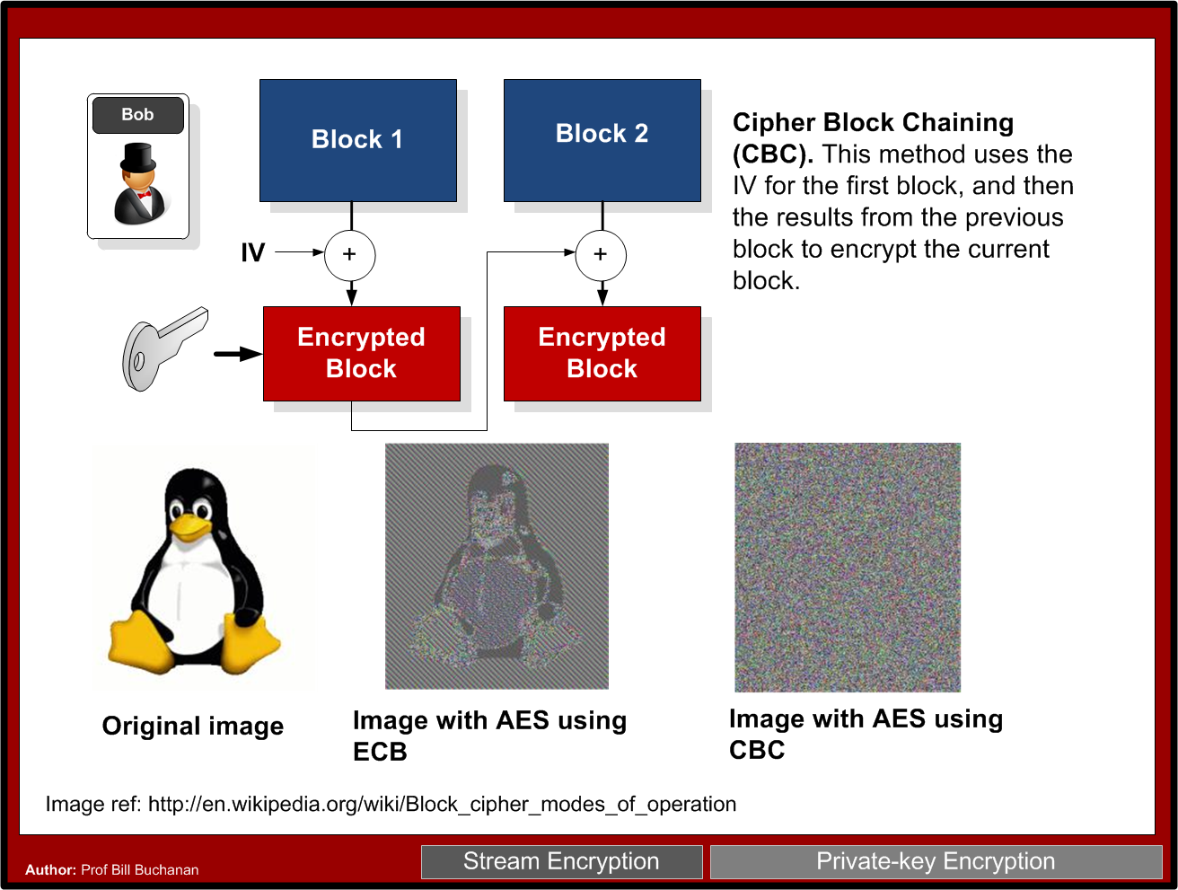

Slide 29
Symmetric Key Basics Block or Stream? Secret Key Methods Salting AES Key Entropy Prof Bill Buchanan https://asecuritysite.com/symmetric

Slide 30
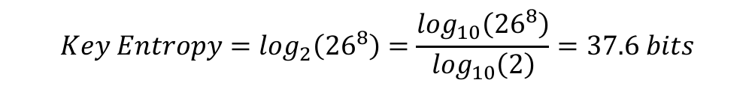
Key Entropy
Password definition | Number of possible characters | Total number of passwords | Entropy (bits)
[0-9] | 10 | 100,000,000 | 26.6
[a-z] | 26 | 2.08827x10¹¹ | 37.6
[a-zA-Z] | 52 | 5.34597x10¹³ | 45.6
[a-zA-Z0-9] | 62 | 2.1834x10¹⁴ | 47.6
[a-zA-Z0-9$%!@+=] | 68 | 4.57163x10¹⁴ | 48.7

Slide 31
Symmetric Key Basics Block or Stream? Secret Key Methods Salting AES Key Entropy Prof Bill Buchanan OBE https://asecuritysite.com/symmetric

